Slide 1



OSPF in Short
  Routing information is shared through Link-state updates (LSAs)
  It’s a link state protocol
  It uses SPF (shortest path first) or dijkistra algorithm
  Unlimited hop count
  Metric is cost (cost=10 ^8/B.W.)
  Administrative distance is 110
  It is a classless routing protocol. It sends the subnet mask in the routing update.
  It supports VLSM and CIDR
  It supports only equal cost load balancing
  Introduces the concept of Area’s to ease management and control traffic
  Provides hierarchical network design with multiple different areas
  Must have one area called as area 0
  All the areas must connect to area 0
  Scales better than Distance Vector Routing protocols.
  Supports Authentication
  Updates are sent through multicast address 224.0.0.5
  Faster convergence.

Slide 2
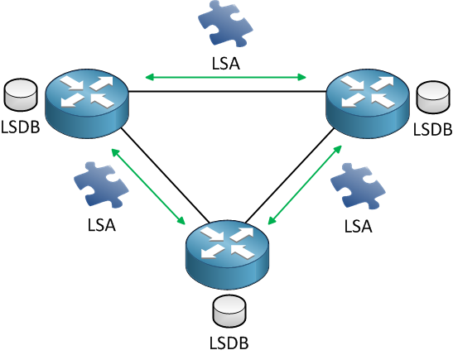
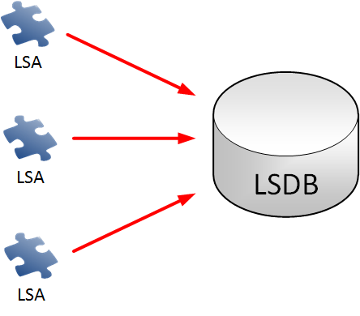
OSPF Intro

Slide 3
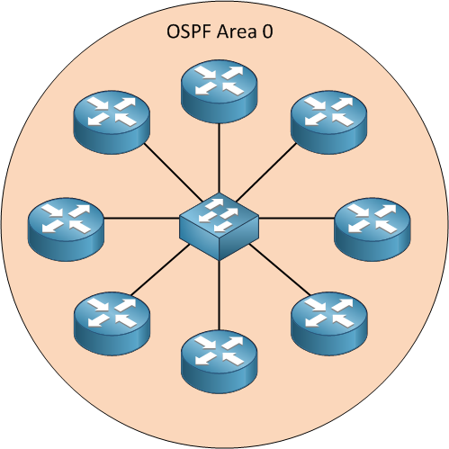
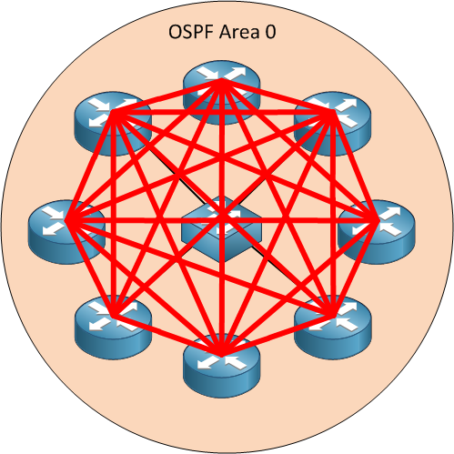
OSPF intro(Cont.)

Slide 4
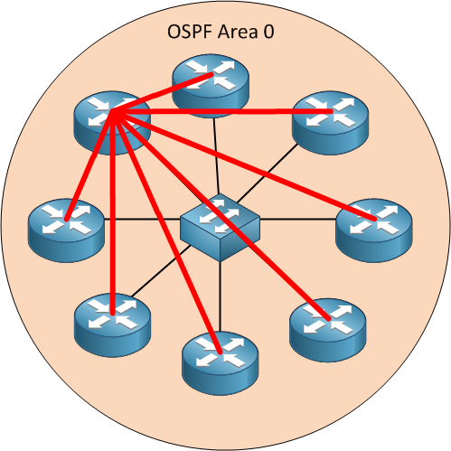
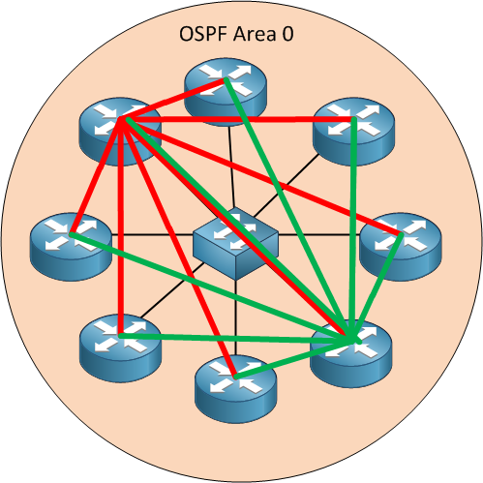
OSPF intro(Cont.)

Slide 5
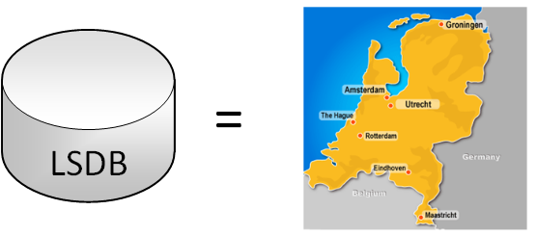
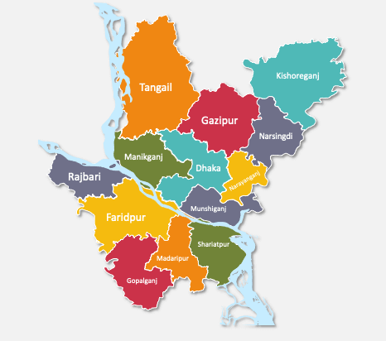
OSPF intro(Cont.)

Slide 6
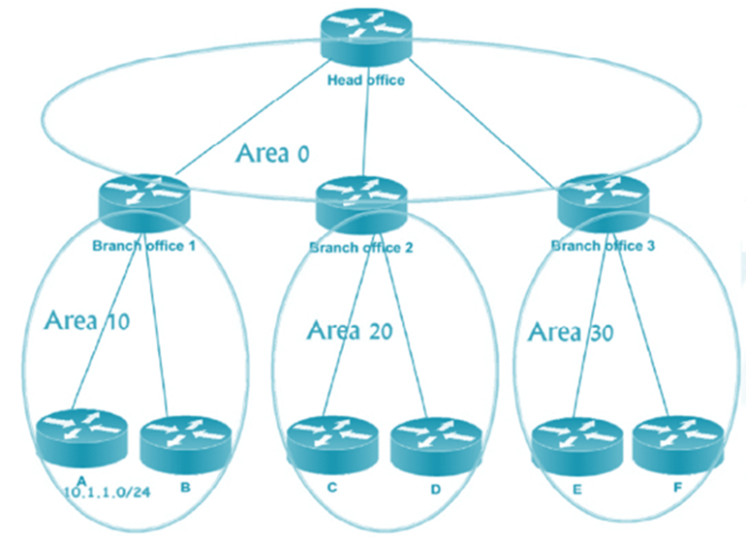
Concept of Area
Area is logical grouping of Routers
All the routers maintain same database within the same Area
Any change impact all the routers with the same area.
Impact:
  Minimizes size of database
  Restrict any changes with in that area. ( not flood outside area)
  Routers with in the same area participate in Algorithm

Slide 7
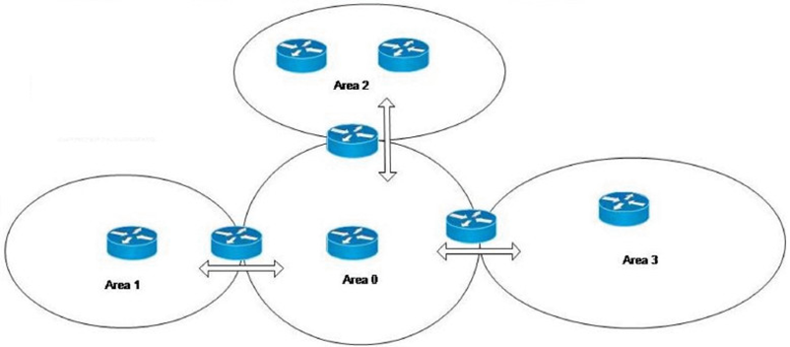
OSPF area design Rules
Must have on area called as area 0 ( called backbone area)
All the no-backbone areas must connect to area 0. ( Area 0 must be transit area)
At least one-Area Border Router (connecting two or more area)
Interface of both routers facing must be in the same area.

Slide 8
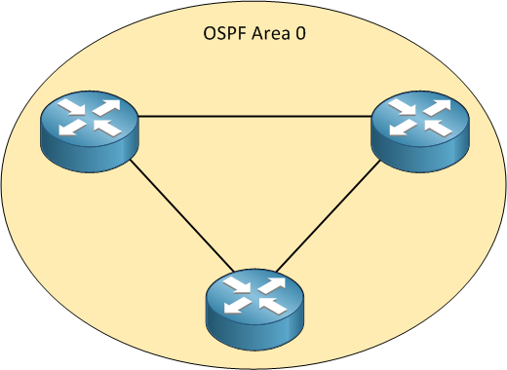
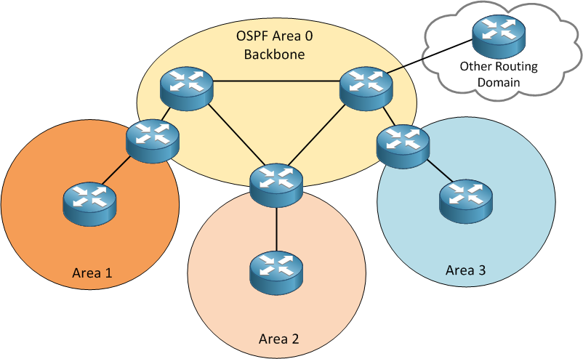
Area Terminology

Slide 9
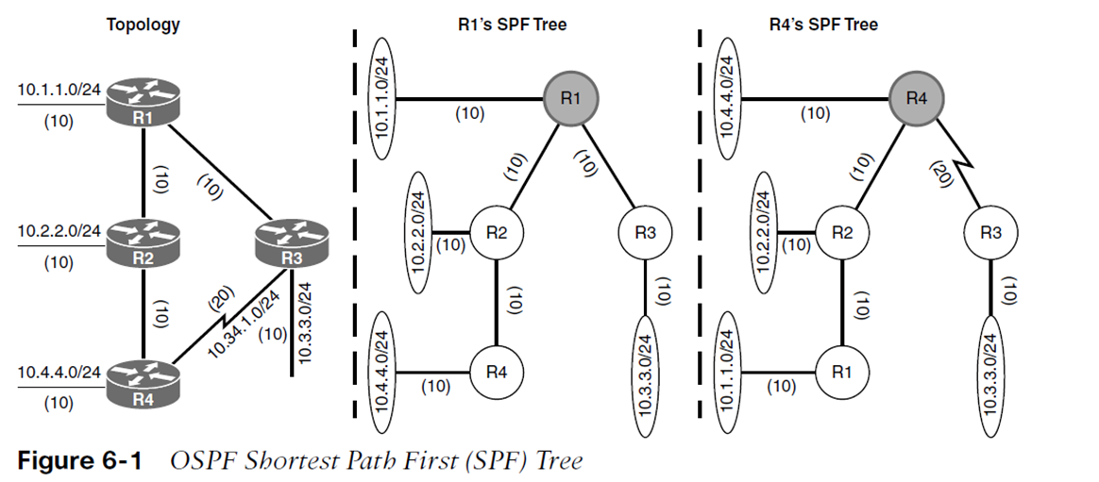
SFP Tree

Slide 10
Link-State Packets (LSPs)
There are five types of OSPF Link-State Packets (LSPs).
  Hello: are used to establish and maintain adjacency with other OSPF routers. They are also used to elect the Designated Router (DR) and Backup Designated Router (BDR) on multi-access networks (like Ethernet or Frame Relay).
  Database Description (DBD or DD): contains an abbreviated list of the sending router’s link-state database and is used by receiving routers to check against the local link-state database
  Link-State Request (LSR): used by receiving routers to request more information about any entry in the DBD
  Link-State Update (LSU): used to reply to LSRs as well as to announce new information. LSUs contain seven different types of Link-State Advertisements (LSAs)
  Link-State Acknowledgement (LSAck): sent to confirm receipt of an LSU message

Slide 11
OSPF Process
Down
init
2 way
Exstart
Exchange
Loading
Full

Slide 12
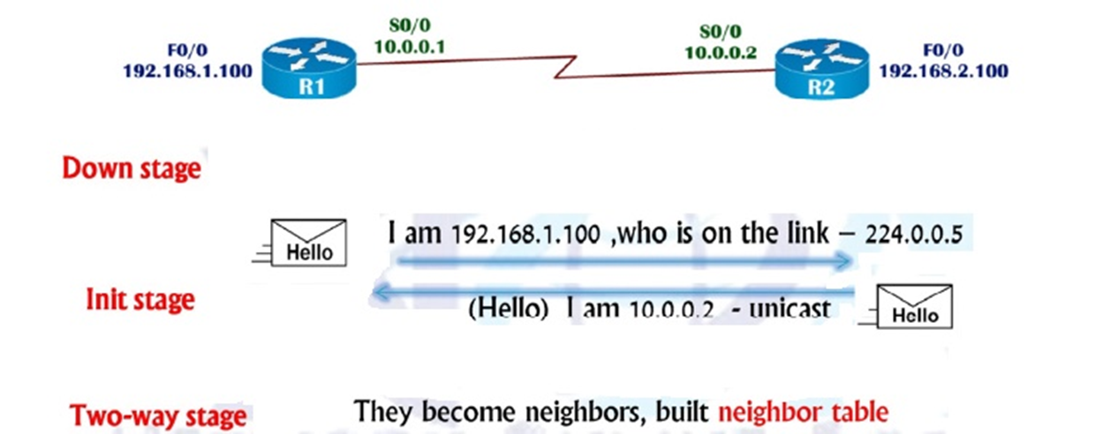
OSPF Process(Cont.)

Slide 13
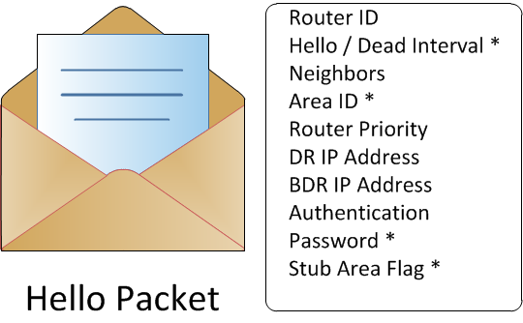
OSPF Hello Packet

Slide 14
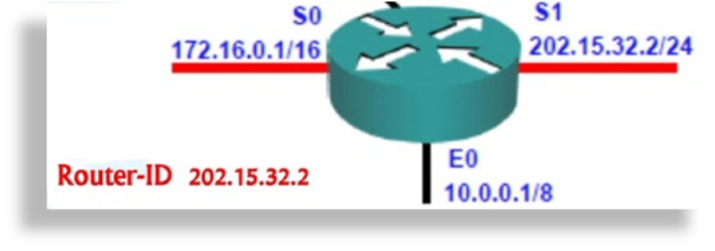
OSPF router ID
Used to identify the router inside the OSPF database
OSPF identify using same ID in all directions
Default uses highest IP address of active physical interface

Slide 15
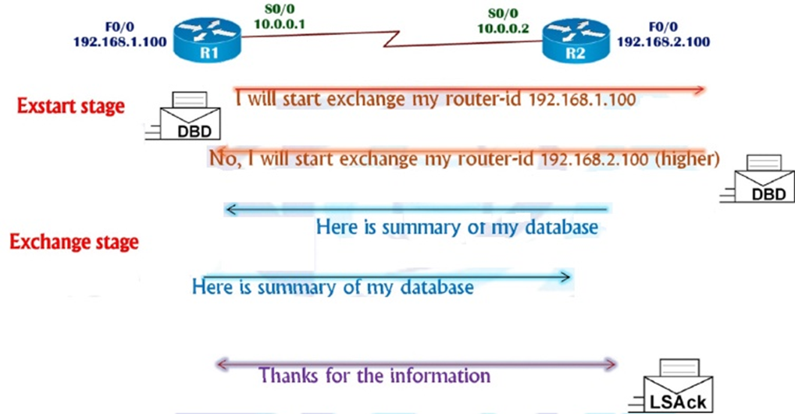
OSPF Process(Cont.)

Slide 16
OSPF Tables
Neighbor Table
  Contains list of directly connected routes
  # show ip ospf neighbor
Routing Table
  The best route to destination
  # show ip route
Database table
  Referred to as LSDB ( link state database)
  Contains information about all the possible routes to the networks with in the area
  - # show ip ospf database

Slide 17
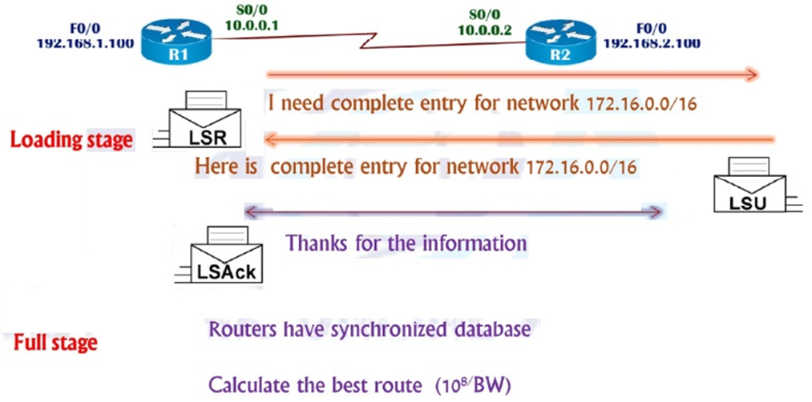
OSPF Process(Cont.)

Slide 18
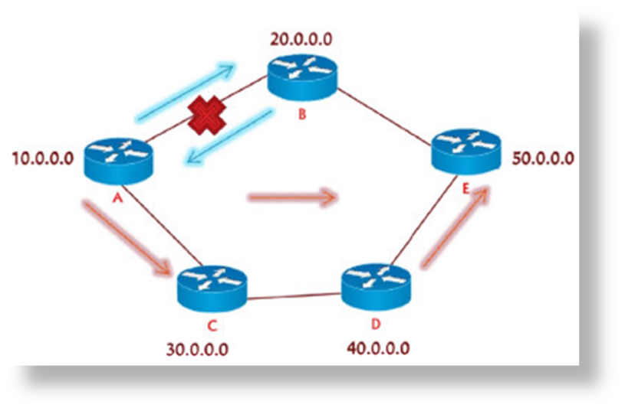
OSPF Convergence
Incremental updates
Periodically send hello packets are sent every 10 seconds (dead-40 sec)
Convergence rate is fast (40 sec)

Slide 19
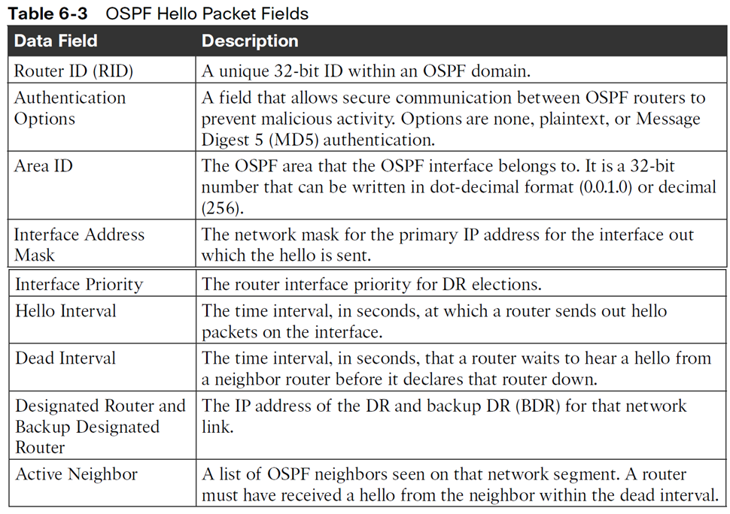
OSPF Hello Packets

Slide 20
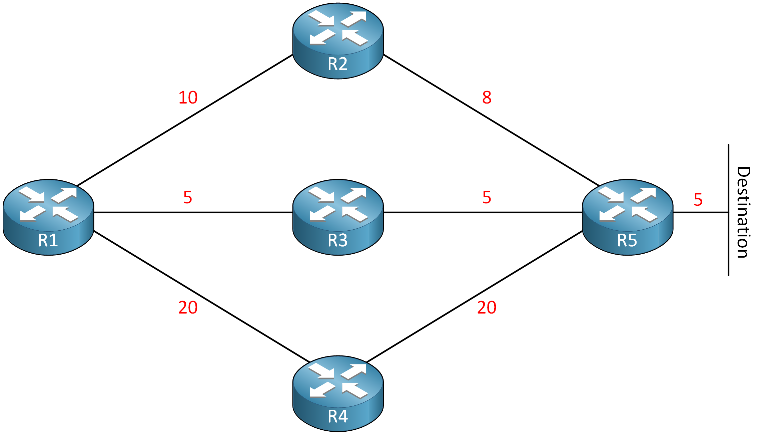
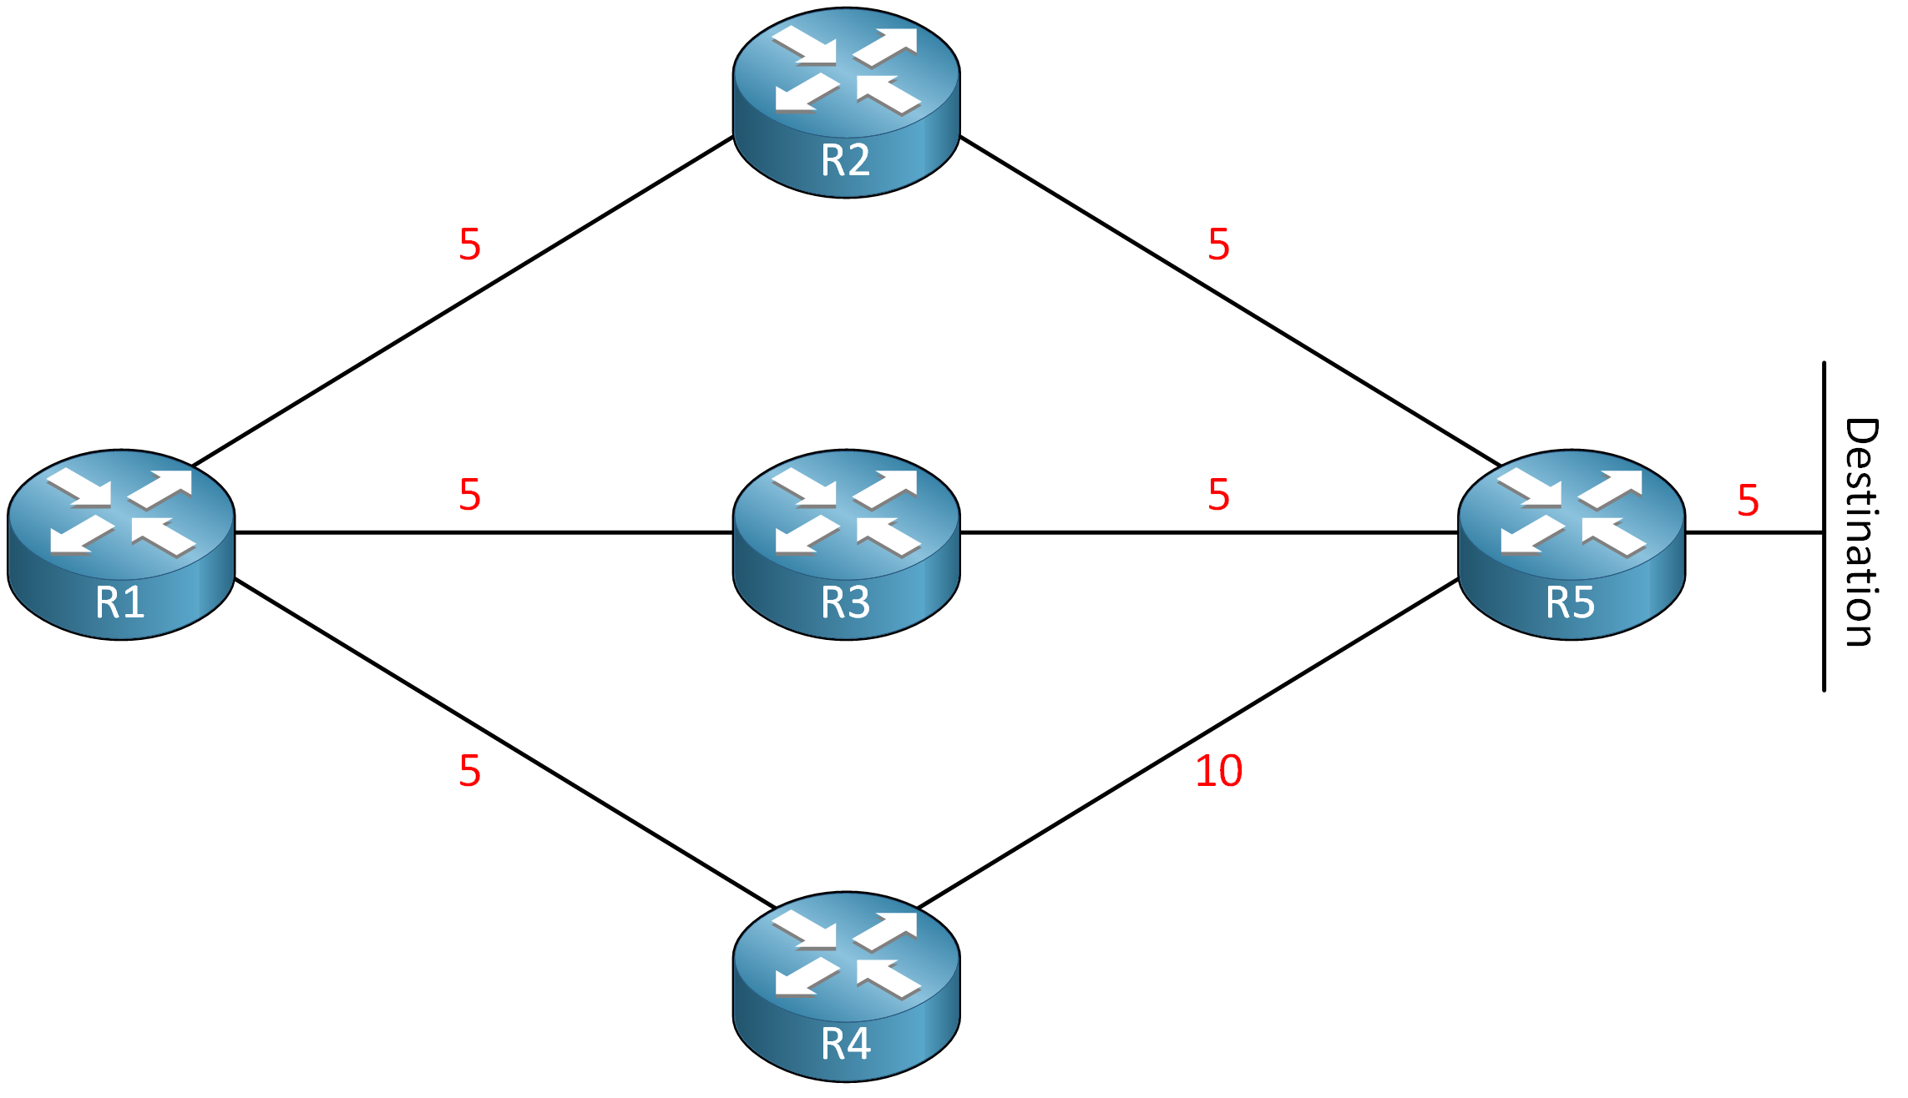
OSPF Path Calculation

Slide 21
OSPF LoadBalancing Criteria
Paths must have an equal cost.
OSPF adds paths with an equal cost in the routing table.
The default value is a maximum of 4 equal-cost paths.
The maximum value is 32 equal-cost paths (this could depend on your platform and/or IOS version though)
To make paths equal cost, change the “cost” of a link.

Slide 22
OSPF Configuration
The configuration process for OSPF occurs mostly under the OSPF process, but some OSPF options go directly on the interface configuration submode.
The OSPF process ID is locally significant but is generally kept the same for operational consistency.
OSPF is enabled on an interface using two methods:
  OSPF network statement
  Interface-specific configuration

Slide 23
OSPF Configuration (Cont.)
Method:1
  Router(config)# router ospf PROCESS_ID
  Router(config-router)# network INTERFACE_IP WC_MASK area AREA_ID
  Example:
  Router(config)# router ospf 1
  Router(config)# network 10.1.2.1 0.0.0.0 area 0
Method 2:
  Router(config)# interface INT_NAME
  Router(config-if)# ip ospf PROCESS-ID area AREA_ID
  Example:
  Router(config)#interface se1/0
  Router(config-if)# ip ospf 1 area 0

Slide 24
OSPF Verification
Show ip protocols
show ip ospf interface
show ip ospf interface brief
Show ip ospf database
show ip ospf neighbor
show ip route ospf

Slide 25
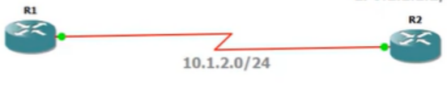
OSPF Neighborship
An OSPF neighbor is a router that shares a common OSPF-enabled network link.
OSPF routers discover other neighbors through the OSPF hello packets.
An adjacent OSPF neighbor is an OSPF neighbor that shares a synchronized OSPF database.
Each OSPF process maintains a table for adjacent OSPF neighbors and the state of each router.

Slide 26
Requirements for Adjacency
The following list of requirements must be met for an OSPF neighborship to be formed:
  The RIDs must be unique between the two devices. To prevent errors, they should be unique for the entire OSPF routing domain.
  The interfaces must share a common subnet. OSPF uses the interface’s primary IP address when sending out OSPF hellos. The network mask (netmask) in the hello packet is used to extract the network ID of the hello packet.
  The interface maximum transmission unit (MTU) must match because the OSPF protocol does not support fragmentation.
  The area ID must match for that segment.
  The need for a DR must match for that segment.
  OSPF hello and dead timers must match for that segment.
  The authentication type and credentials (if any) must match for that segment.
  Area type flags must be identical for that segment (stub, NSSA, and so on).

Slide 27

OSPF LSA TYPE
LSA TYPE | COMMON Name
1 | Router
2 | Network
3 | Net Summary
4 | ASBR Summary
5 | AS External
6 | Group Membership
7 | NSSA External
8 | External Attributes
9-11 | Opaque

